Slide 1
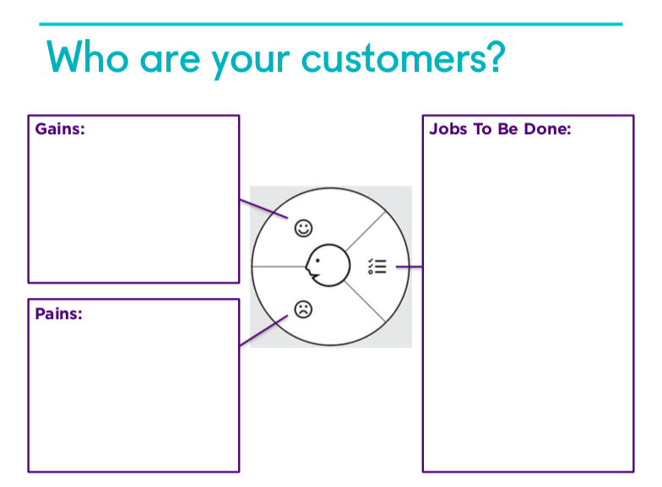
What Are Your Customer’s Attributes?
Peace of mind knowing teen is safe
Look after children
Keep children safe
Often pay for insurance for dependents or include them in family plan
Inform children on good life habits
Getting car insurance quotes is long,
Motivating teen to drive safer is hard
Low driving history makes even great young drivers pay huge insurance premiums
Worried about children’s safety namely their driving & location
Car insurers use their info against them
Data privacy is a big concern with UBI

Slide 2
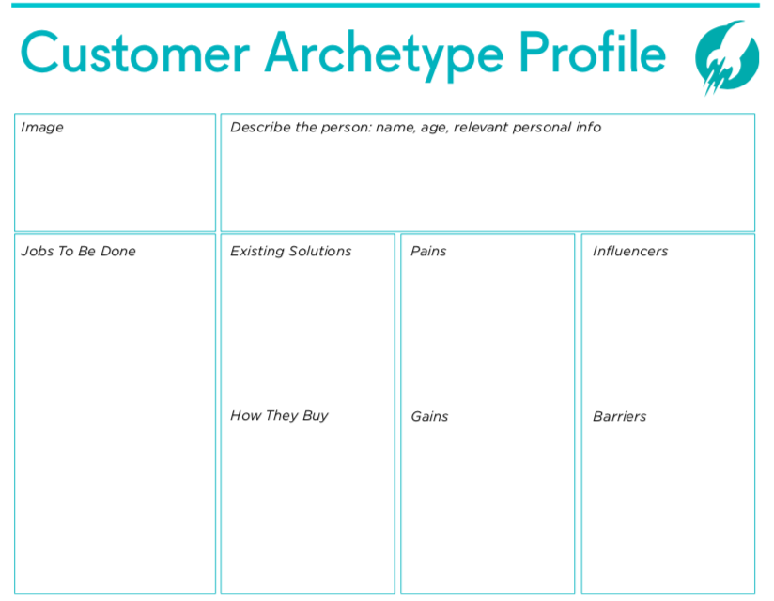
Jessica. White. 42 years old. Tech savvy with large friend group. Mother of 2. Concerned parent with teenage children who drive. Already uses solutions to keep tabs on children. Has subscription services for many things already.
Teach child how to drive
Include child on car insurance policy
Raise and parent children responsibly
Keep children safe when she is present and when not present
Life360
Car insurance app
Car app
Fellow parents in friend group
Car insurance agent
Parenting social media
See page 1
Subscription
Encouraged by insurer
Free with car
Data privacy
Uneager to have a subscription solution
Current solutions are good enough
See page 1

